Slide 1
DEBIAS-M results

Slide 2
Errors
I realised I filtered out the studies we were no longer using but left the taxa… this meant I had taxa with all 0s.
This meant when scaling the data for PCA I got columns with NAs since there was no variance
I went through and fixed the data

Slide 3
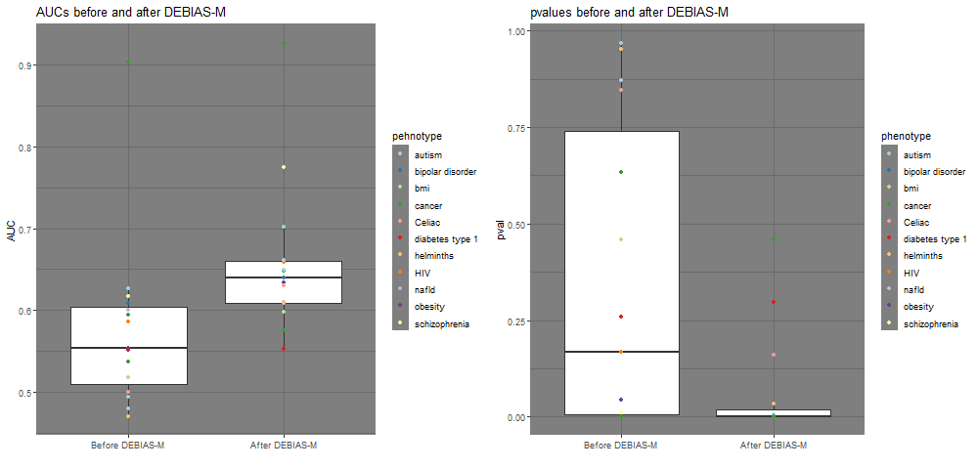
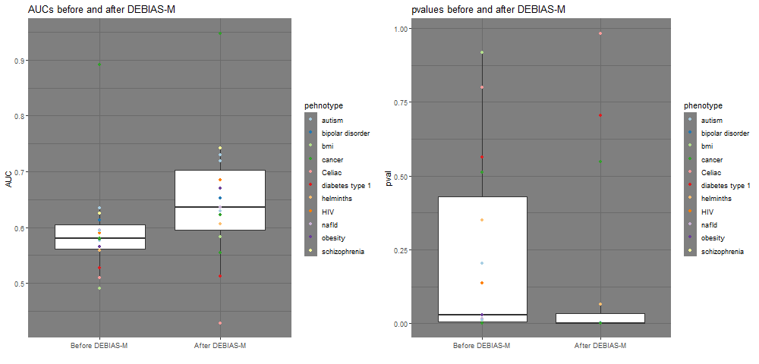
Box plot of AUCs and p-values

Slide 4
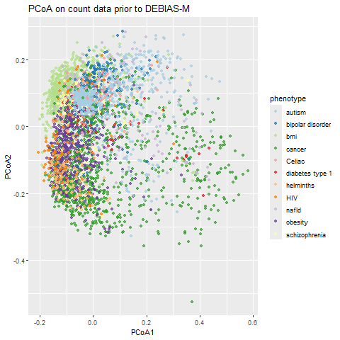

Pre-DEBIAS-M count PCoA

Slide 5
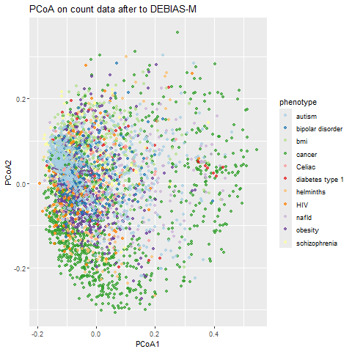
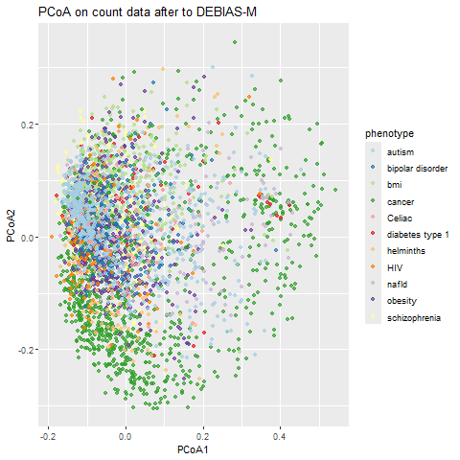
Post-DEBIAS-M count PCoA

Slide 6
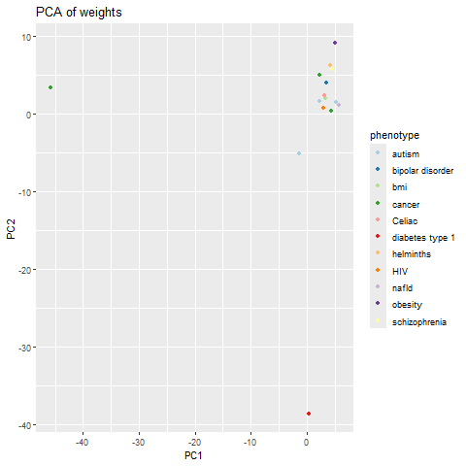
DEBIAS-M weights PCoA

